Slide 1

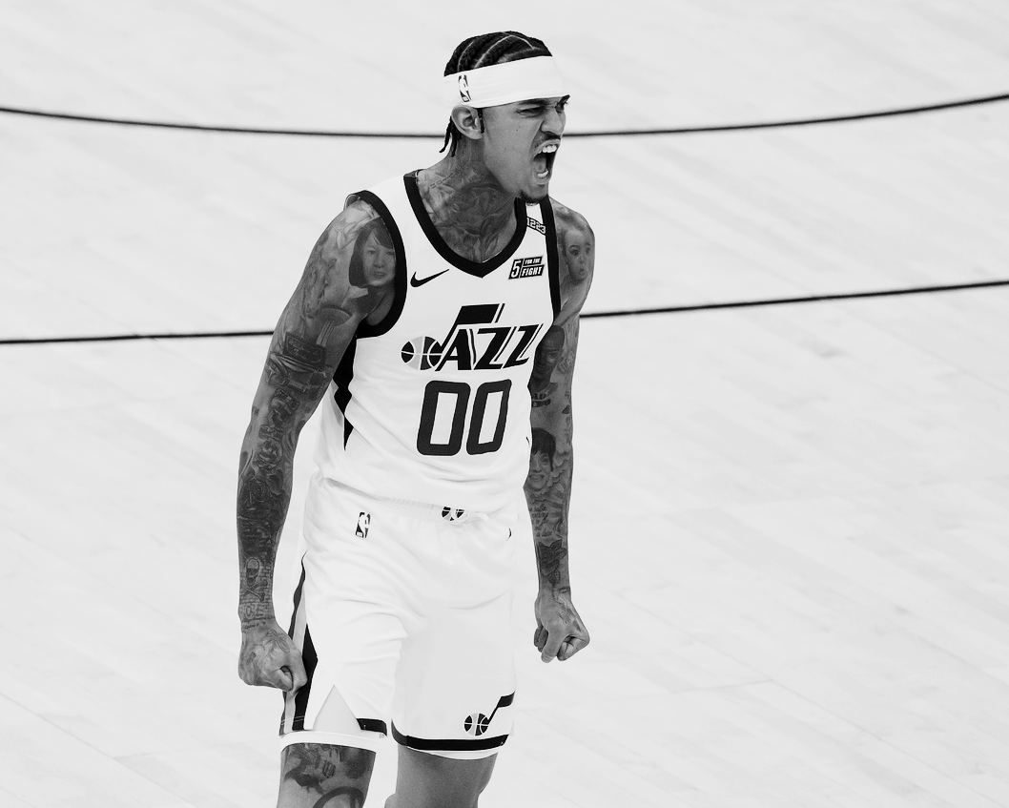
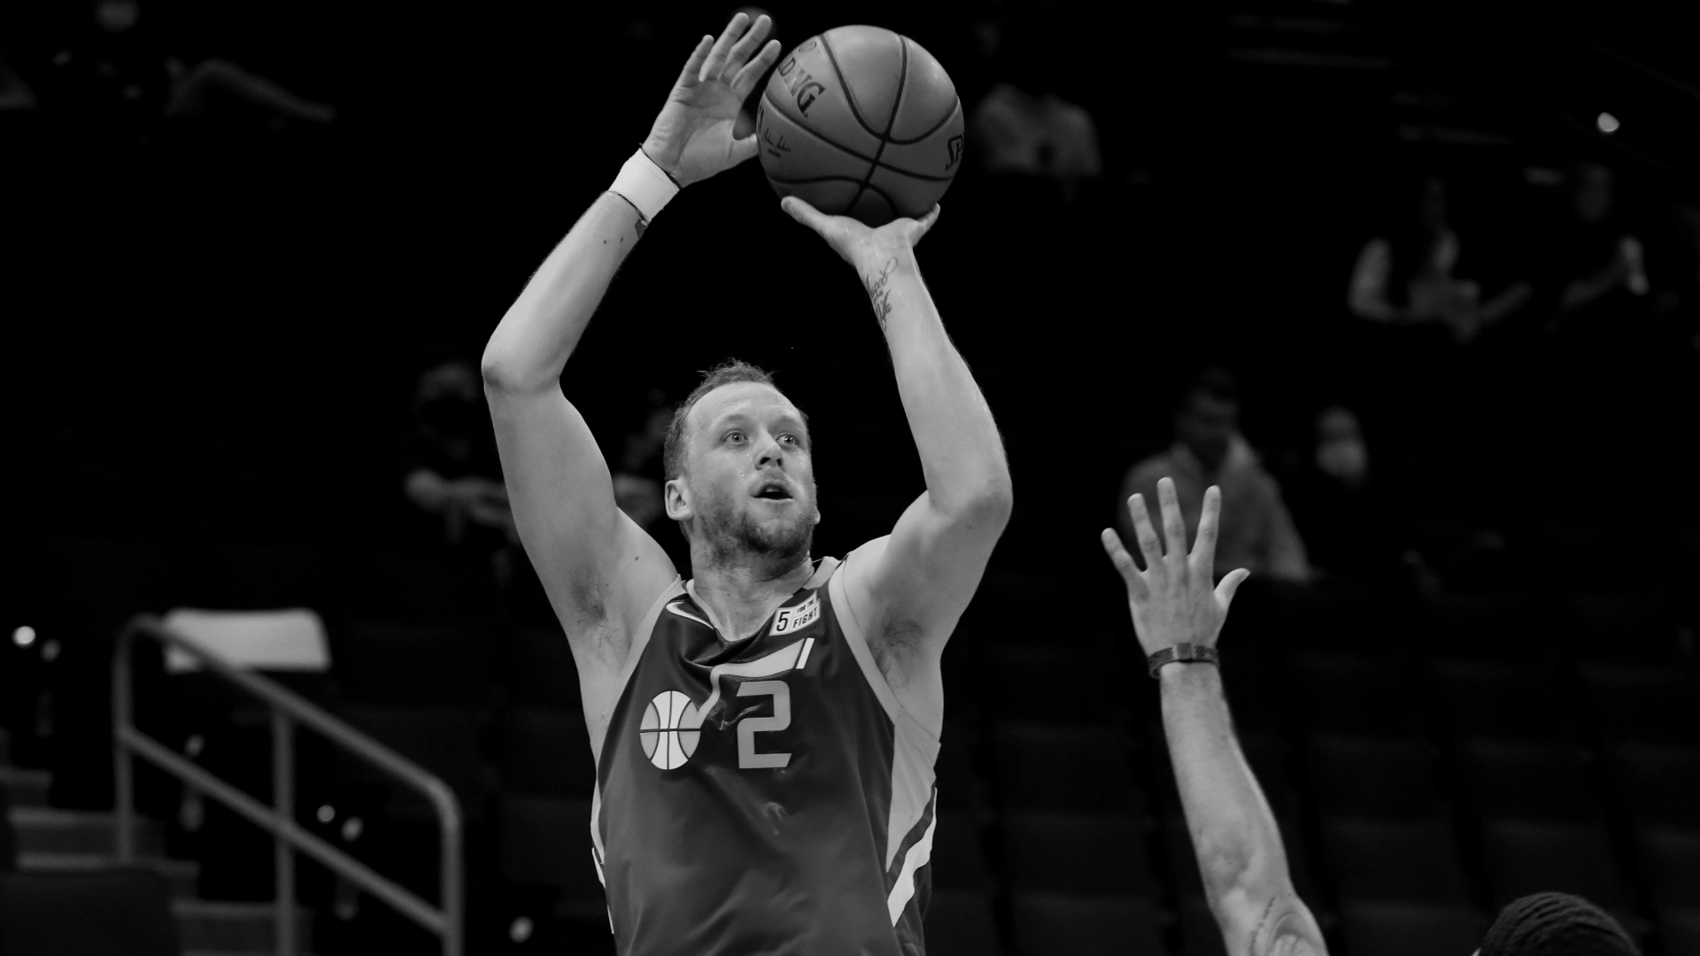
Predicting NBA Player Performance Using Historical Data
Ray LaForte
Casey Mok
Nebe Samuel

Slide 2


Slide 3
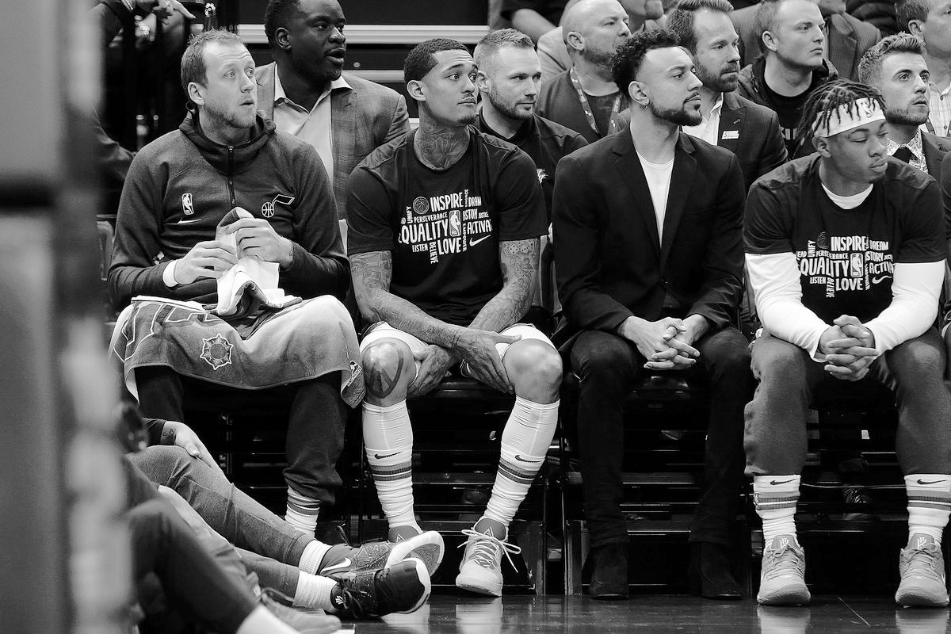
Analytics is TRANSFORMING the NBA

Slide 4

The Project
Our goal
Use historical NBA player data to predict the outcome of player performance for certain statistical categories
Players Involved
Jordan Clarkson - Shooting Guard for the Utah Jazz, 2021 6th Man of the Year. One of the most lethal scorers in the NBA
Predict if he’ll score at least 20 points
Joe Ingles- Point Guard for Utah Jazz, Career 41% Three-Point Shooter
Predict if he’ll make at least three 3-Point shots

Slide 5
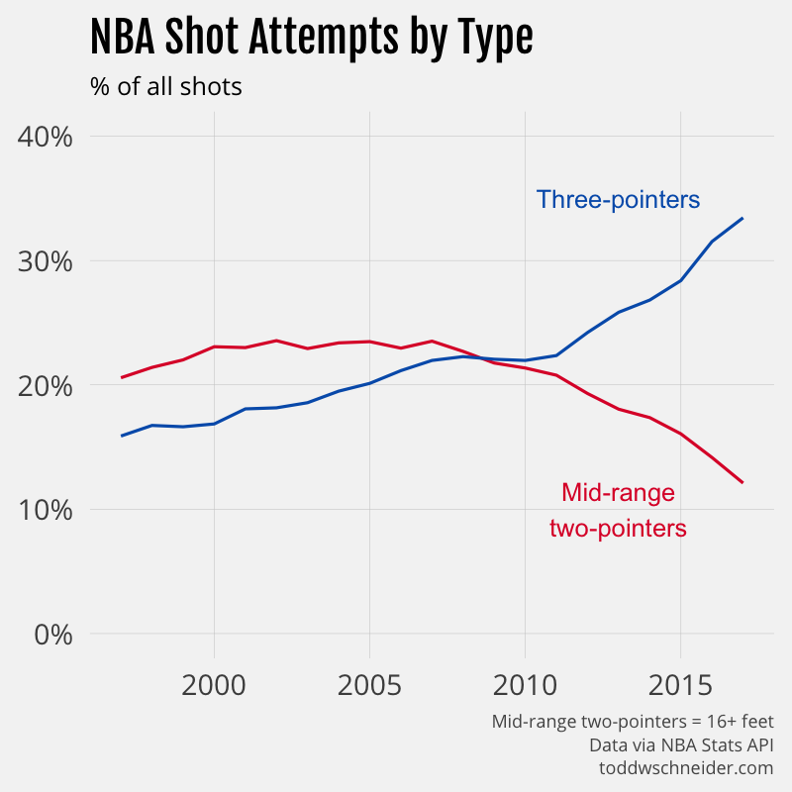
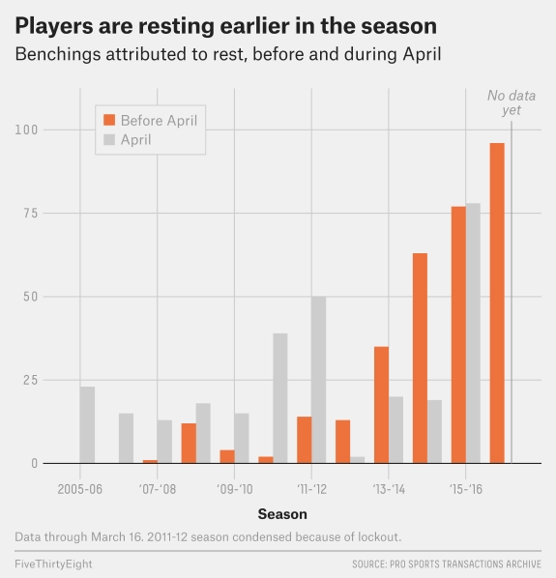

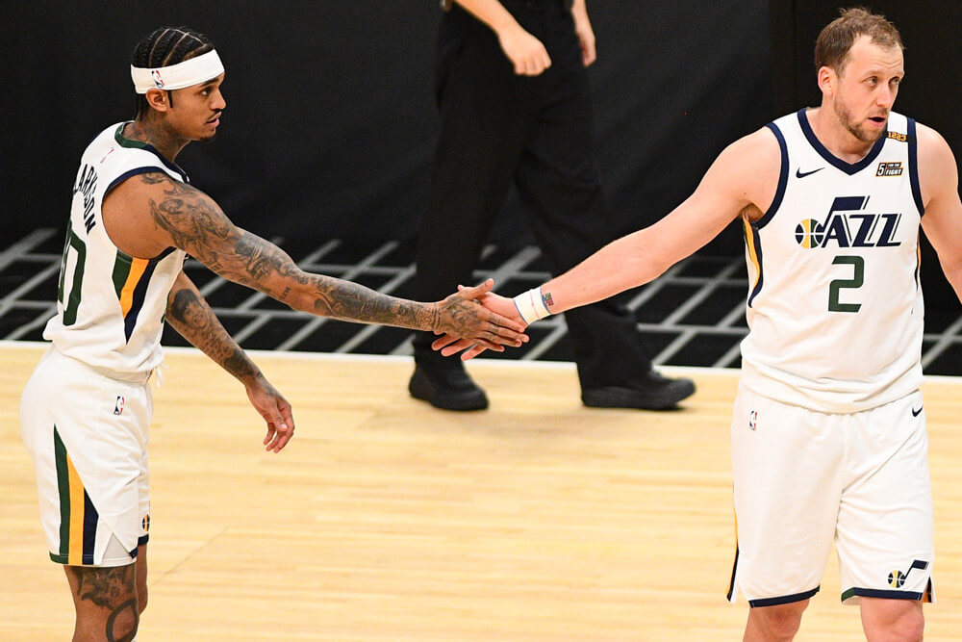
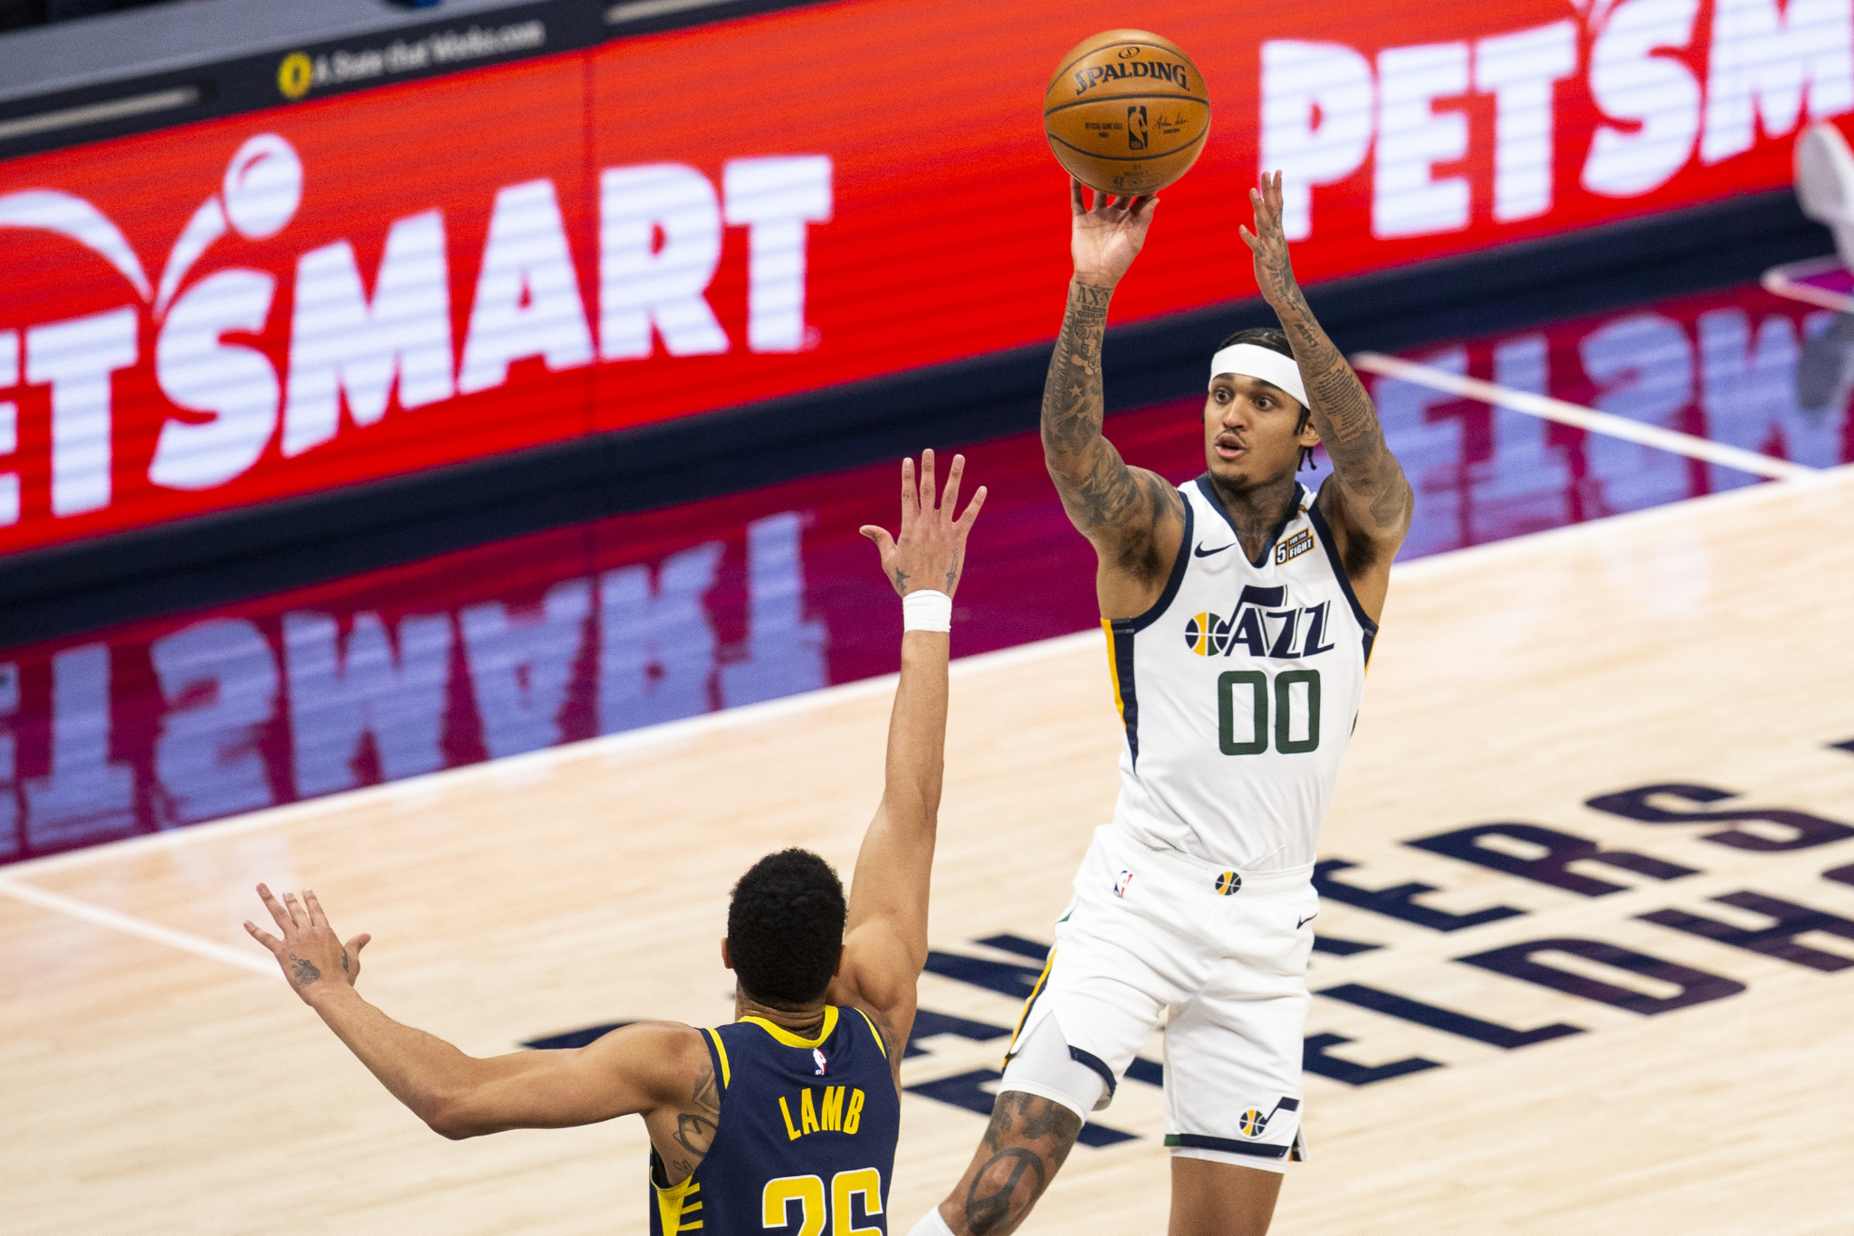
ANALYTICS, ANALYTICS, ANALYTICS
Shot Selection + Team Makeup
Notes:
Darryl Morey(shown in top right pic), the GM of the Rockets, is credited with being one of the first GM’s to utilize analytics to influence how his team is setup to play.

Slide 6
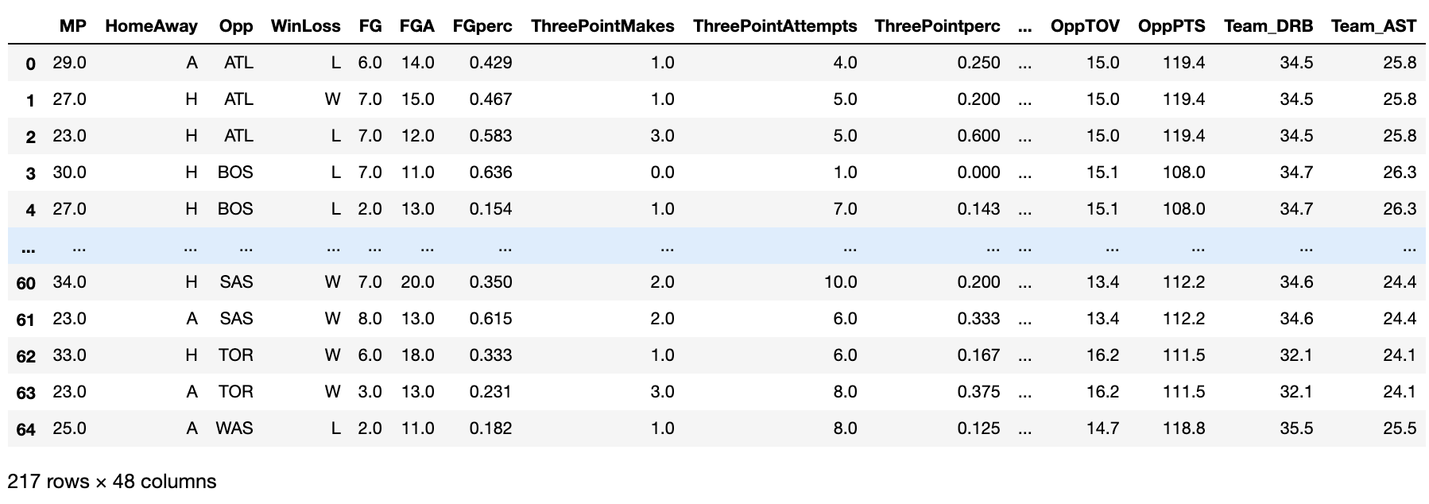
Dataset
2018-2021 Regular Season Game Logs
217 observations with 48 variables for each player
The dataset contains personal statistics from every game that Clarkson and Ingles have played from 2018 through 2021 regular season along with opponent defensive metrics
One row in the dataset represents one game with player stats along with opponent defensive metrics

Slide 7
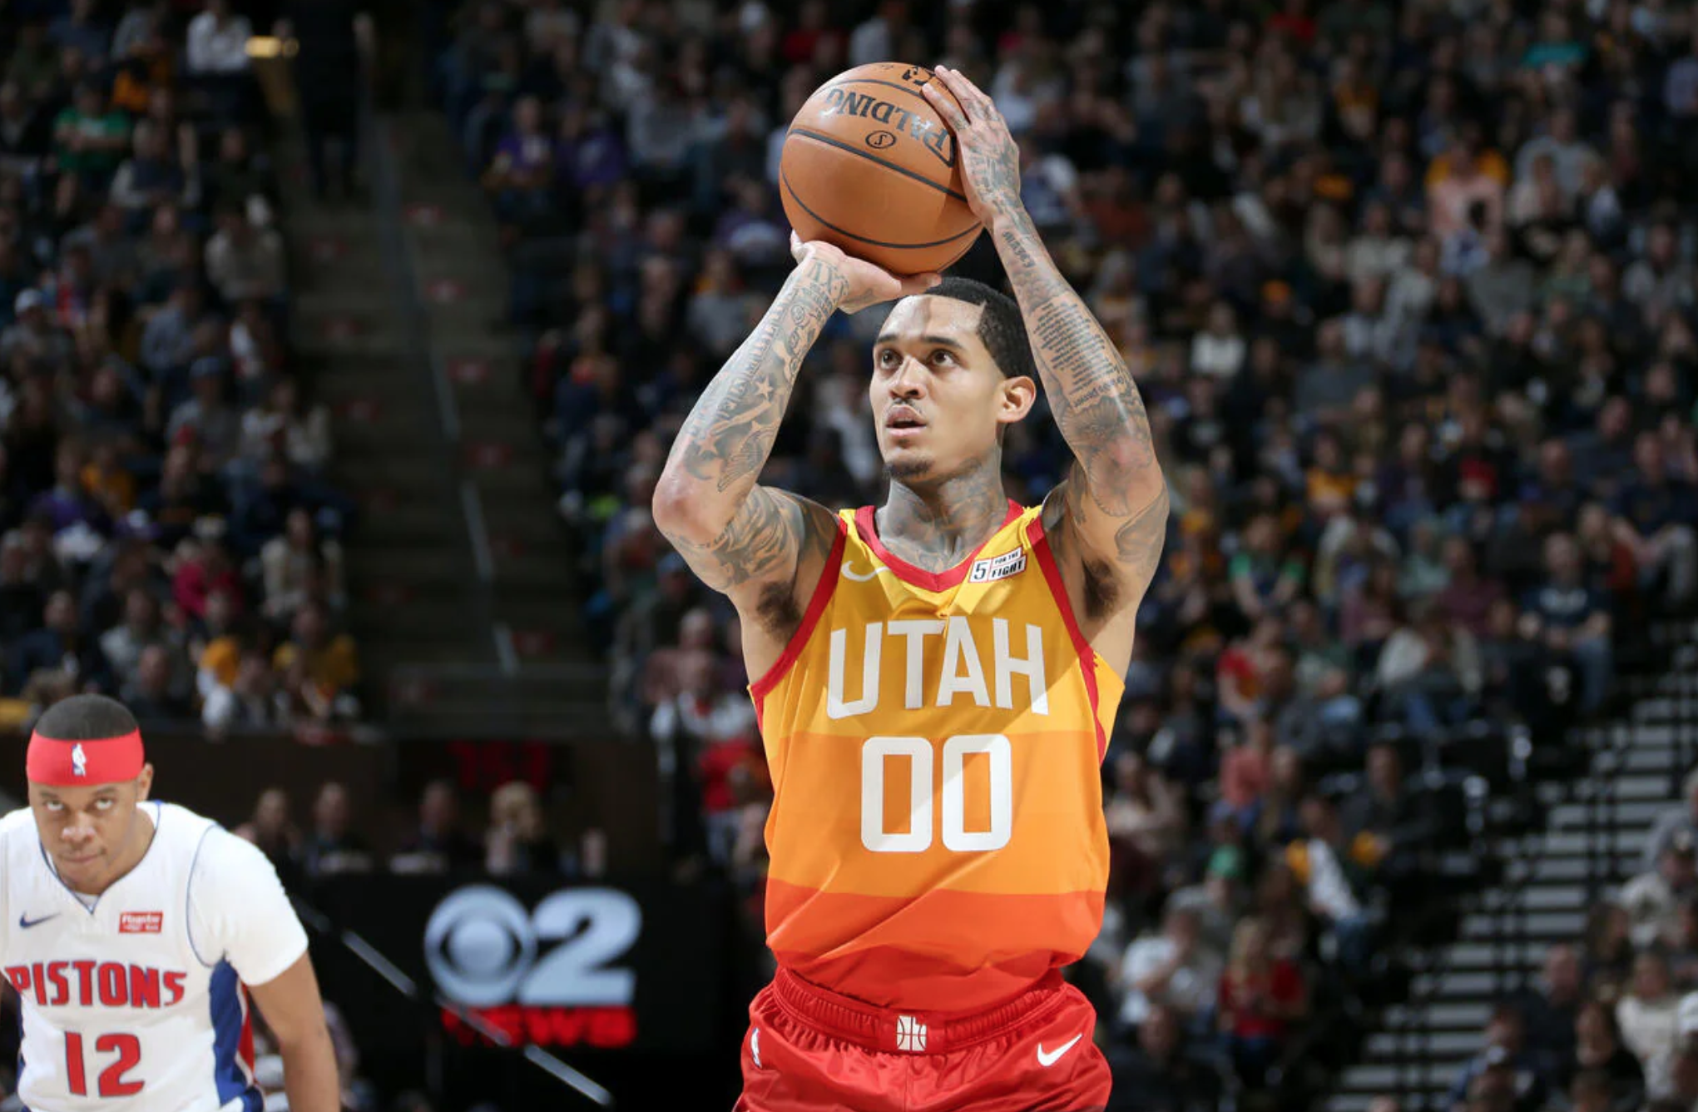
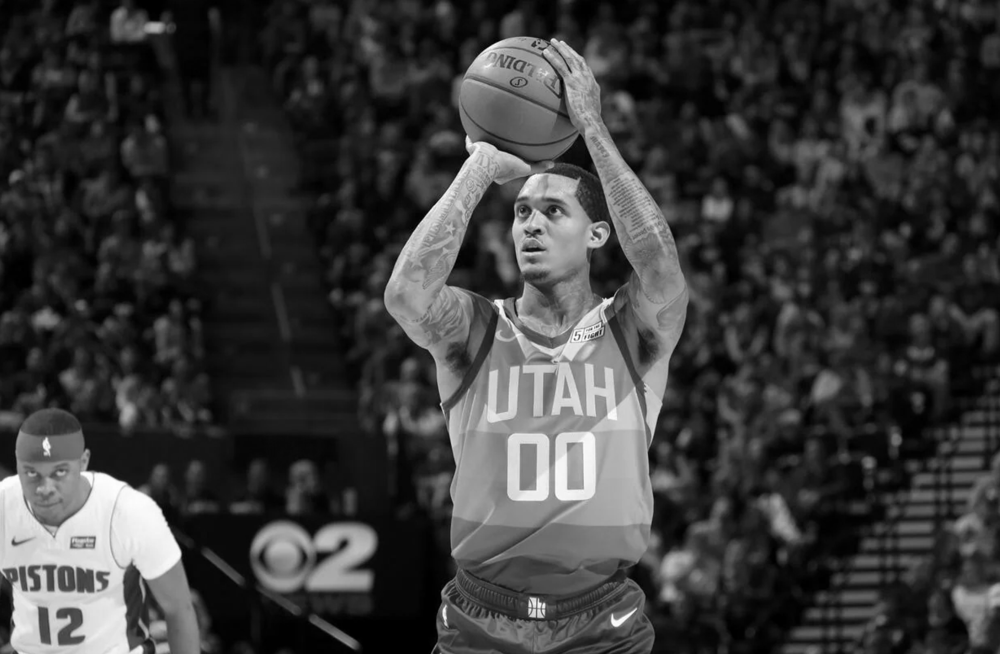

Jordan Clarkson
c

Slide 8

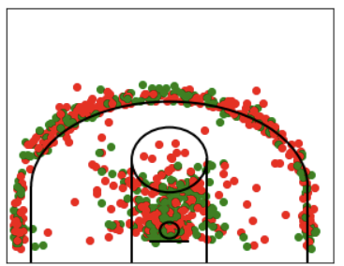
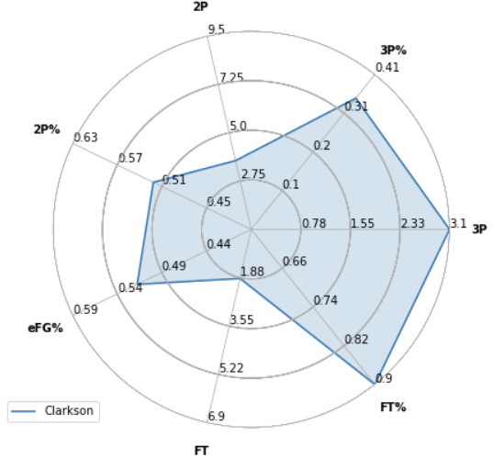
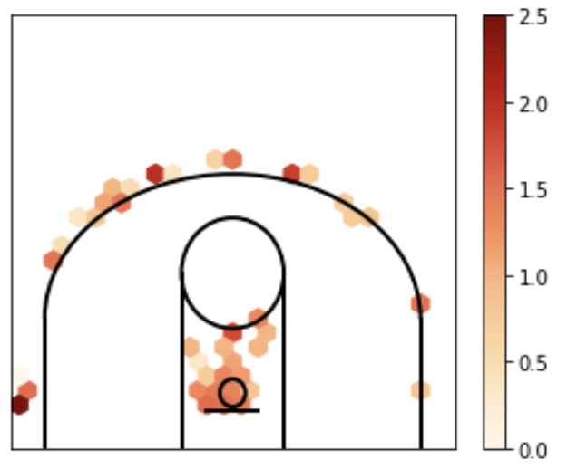
Clarkson 2020/2021 Stats
Raw Season Shot Chart
Hexbin Shot Chart

Slide 9

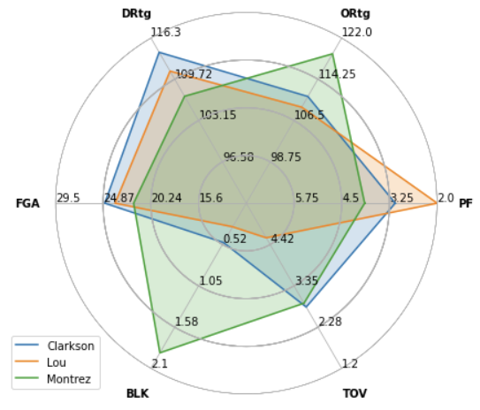
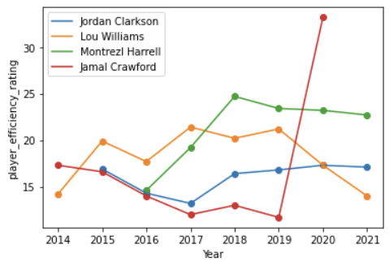
NBA 6th Man of the Year Compare
2020/21 Radar Plot
(PER) Player Efficiency Rating Over Time

Slide 10
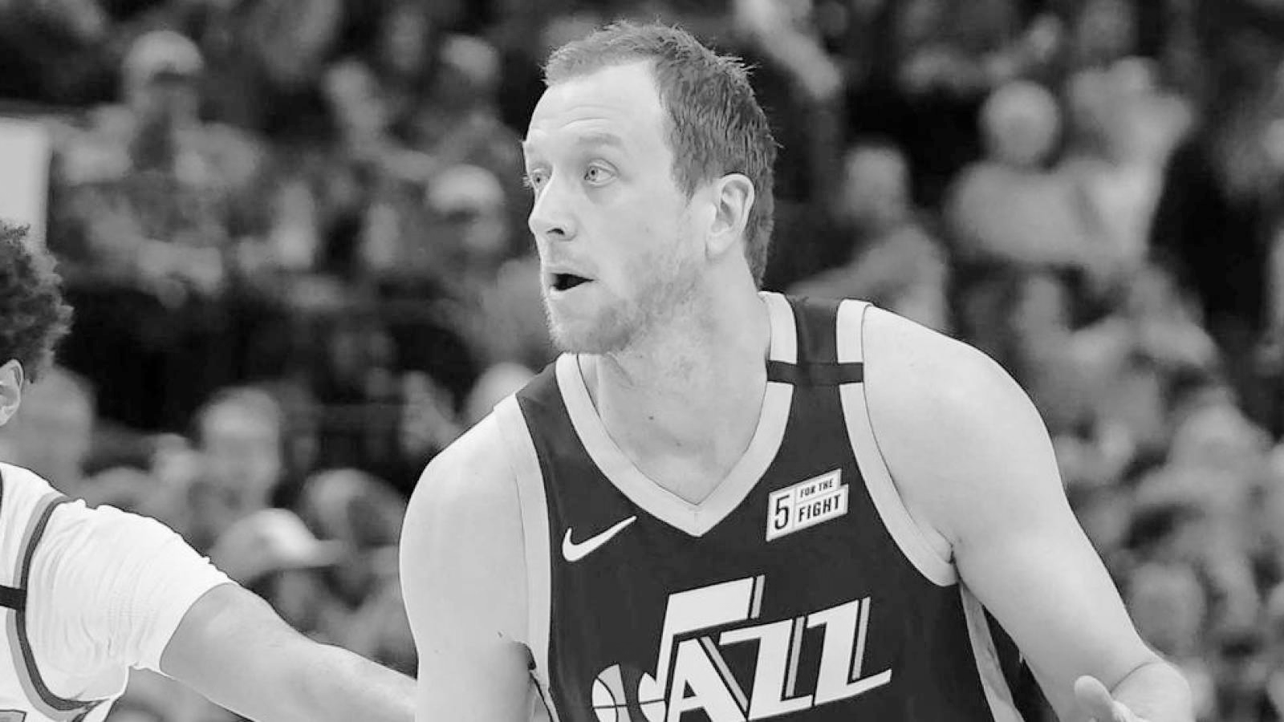
Joe Ingles

Slide 11
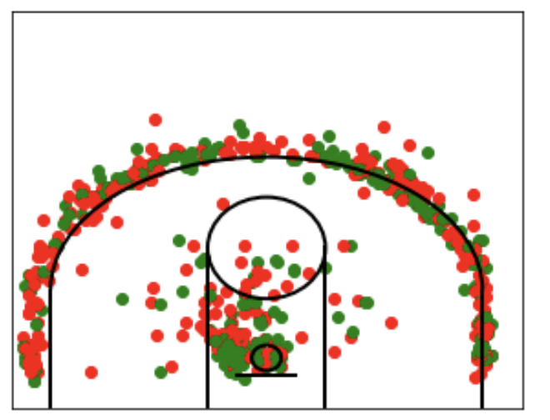
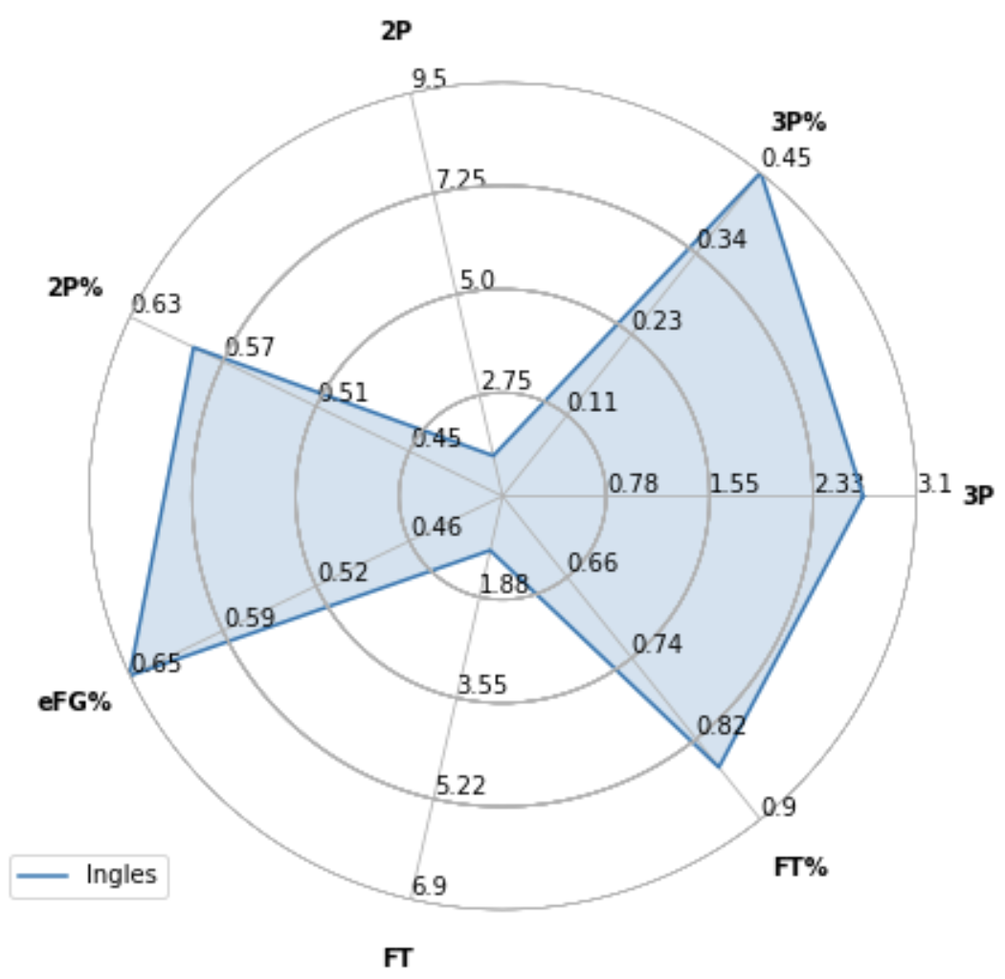
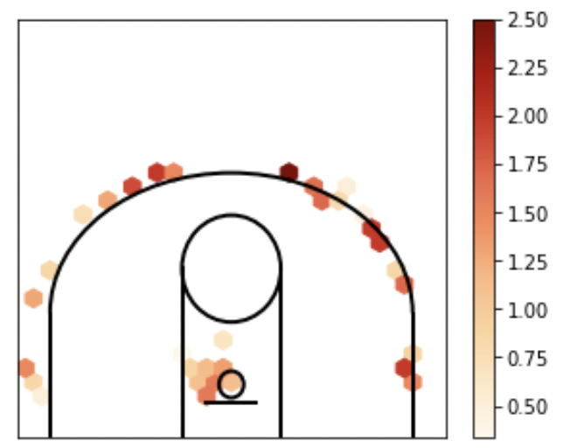
Ingles 2020/2021 Stats
c
Raw Season Shot Chart
Hexbin Shot Chart

Slide 12
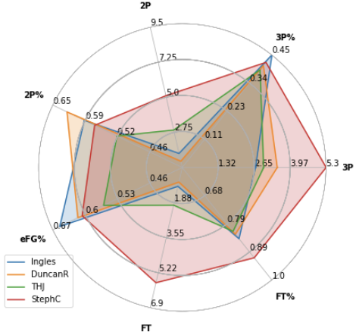
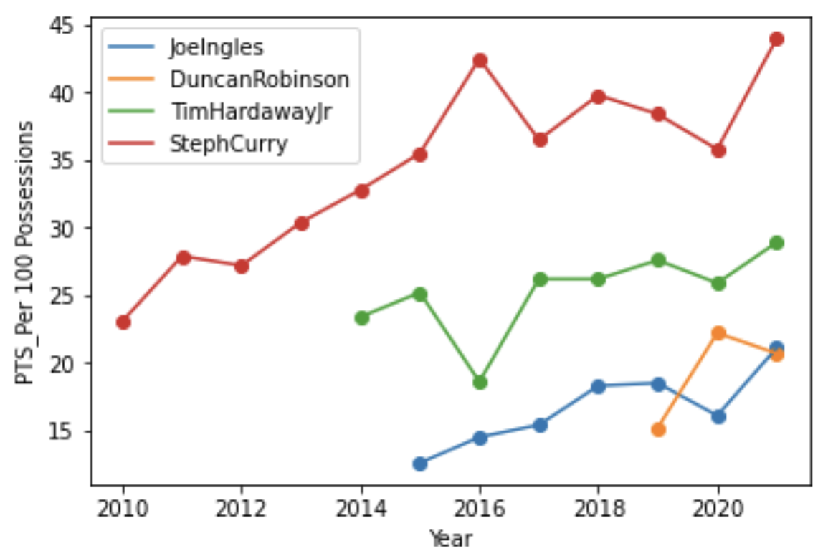
Joe Ingles vs Shooters

Slide 13
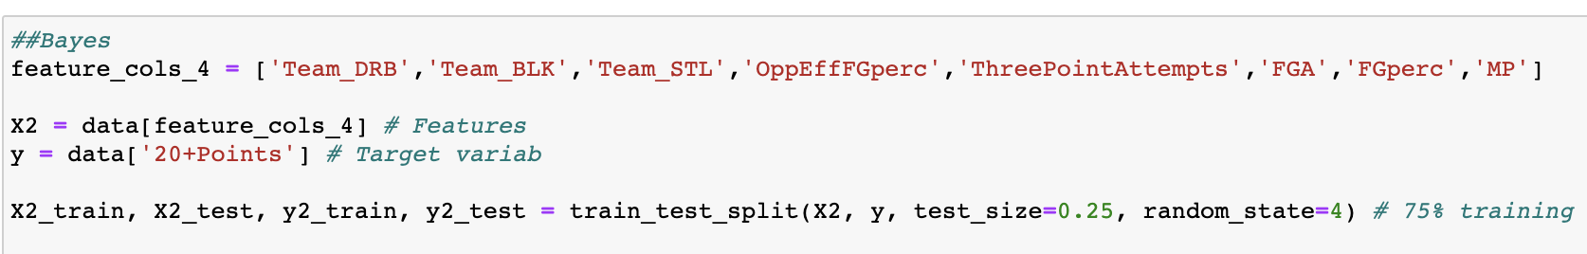
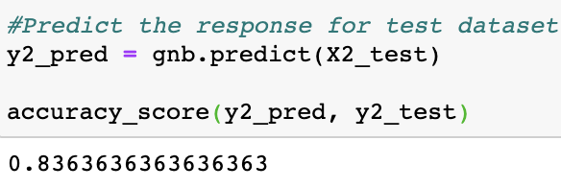
Naive Bayes Models (Jordan Clarkson)
The important variables for Clarkson to score at least 20 were Opponent Defensive Rebounds, Opponent Blocks, Opponent Steals, Opponent Effective Field Goal%, Three-Point Attempts, Overall shot attempts, field goal percentage, and minutes played.
Model produced an accuracy rate of about 84%

Slide 14
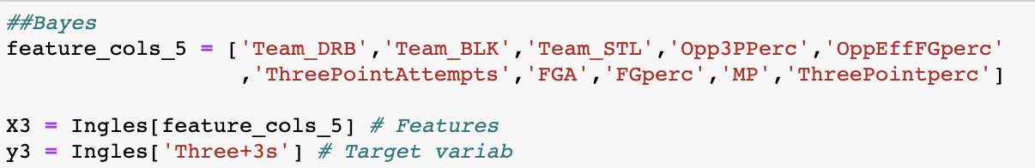
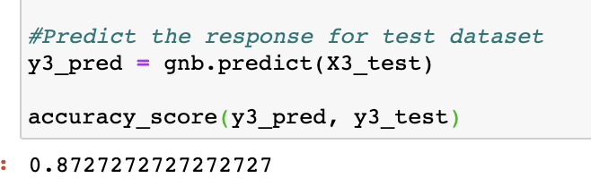
Naive Bayes Models (Joe Ingles)
The important variables for Ingles to make at least 3 Three-point shots were opponent defensive rebounds, opponent blocks, opponent steals, opponent three-point%, opponent effective field goal%, three-point attempts, overall shot attempts, field goal percentage, and minutes played.
Accuracy rate of 87%

Slide 15
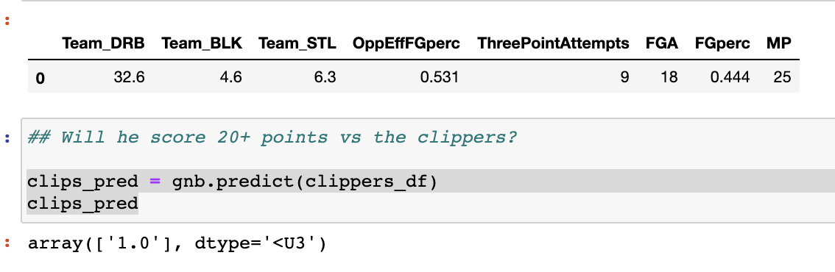
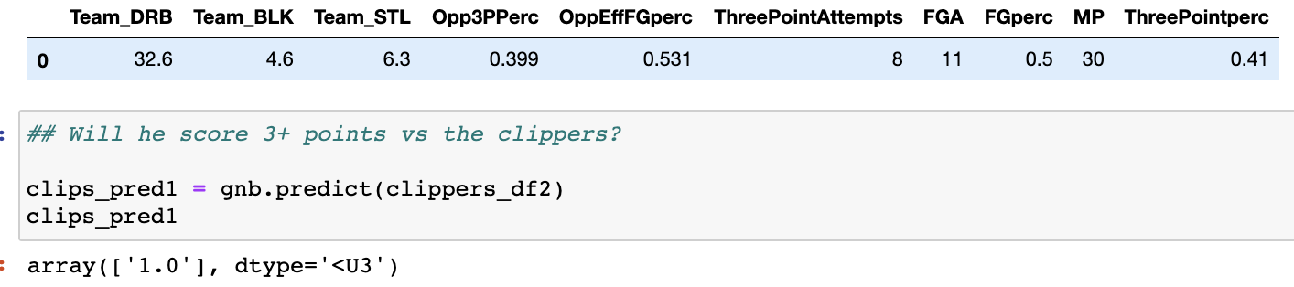
How Does It Translate to Their Current Matchup?
Incorporating their current opponent’s average defensive statistics and the player’s most recent offensive averages, the respective models predict Clarkson to score at least 20 points and Ingles to make at least three 3-pointers vs the Los Angeles Clippers.

Slide 16
Results (First 4 Games vs the LA Clippers)
Jordan Clarkson
Game 1: 18 points, 6/18 from field, 6/14 from 3, 28 mins
Game 2: 24 points, 9/15 from field, 6/9 from 3, 26 mins
Game 3: 14 points, 6/15 from field, 4/9 from 3, 31 mins
Game 4: 8 points, 3/12 from field, 2/8 from 3, 30 mins
Game 5: 10:00 PM EST Tonight
Joe Ingles
Game 1: 8 points, 3/12 from field, 1/8 from 3, 32 mins
Game 2: 19 points, 7/10 from field, 4/7 from 3, 32 mins
Game 3: 19 points, 6/11 from field, 5/8 from 3, 28 mins
Game 4: 19 points, 7/9 from field, 5/7 from 3, 27 mins
Game 5: 10:00 PM EST Tonight

Slide 17
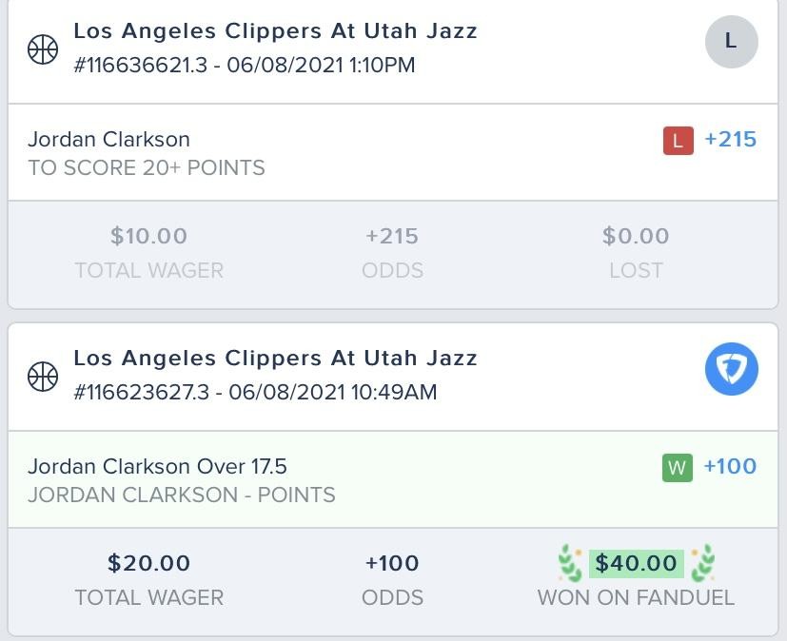
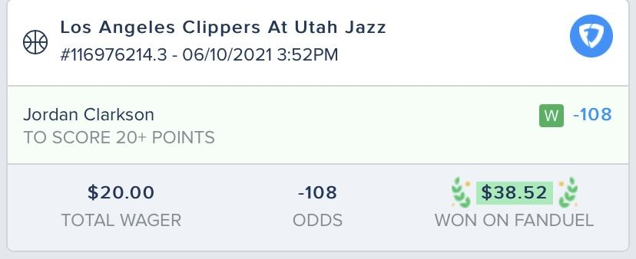
Action
Game 1
Game 2

Slide 18
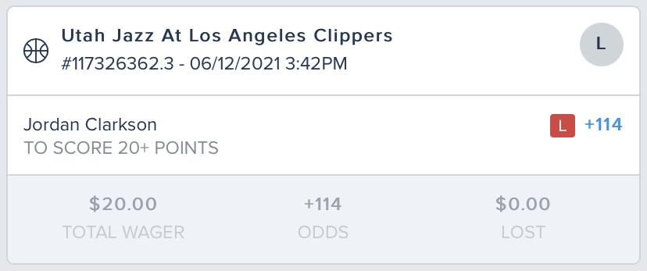
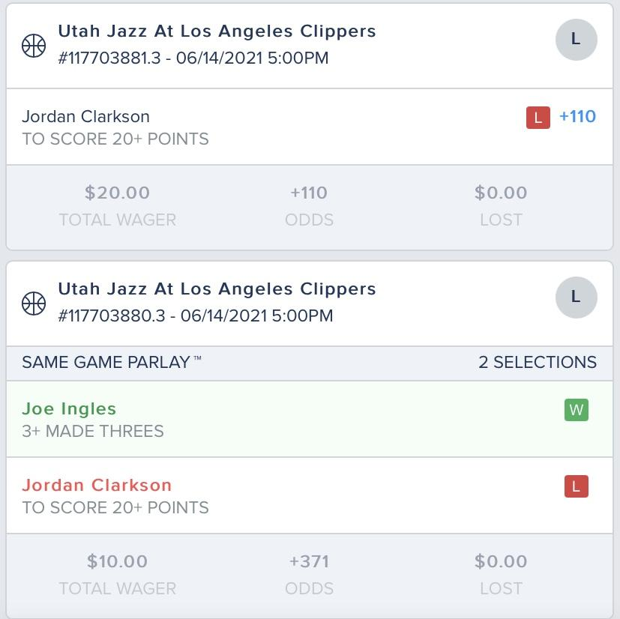
Action
Game 3
Game 4
Overall: Minus $21.48 through 4 games.

Slide 19
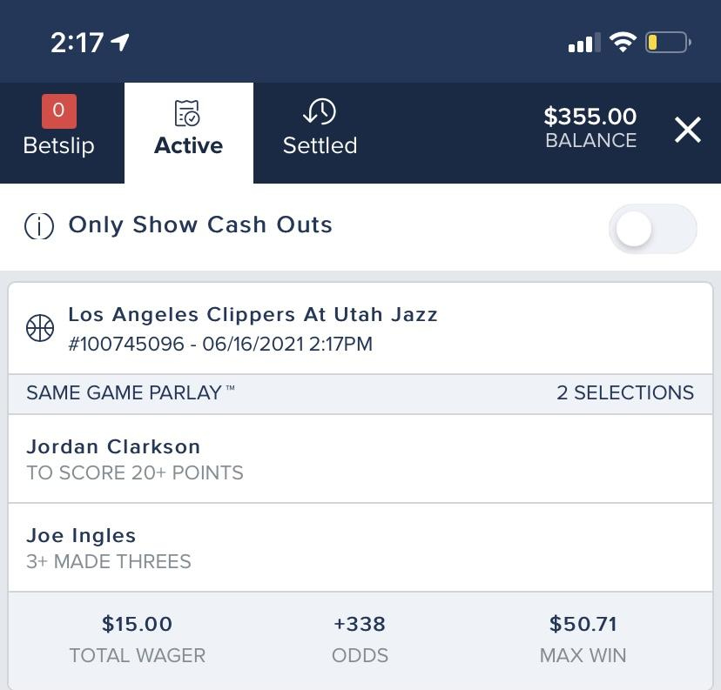
Action for Game 5 Tonight

Slide 20
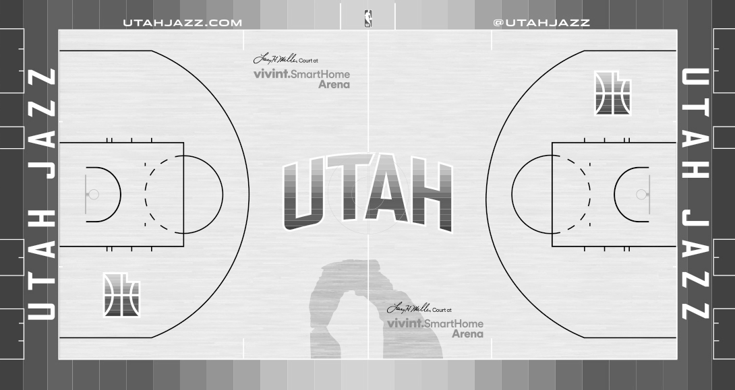
Conclusion
From game to game it’s impossible to say outright how a player will perform
But, player performance is definitely something that can be estimated based off the countless stats that the NBA now tracks .
Player Performance in the regular season is not always a great predictor of post-season performances.

Slide 21
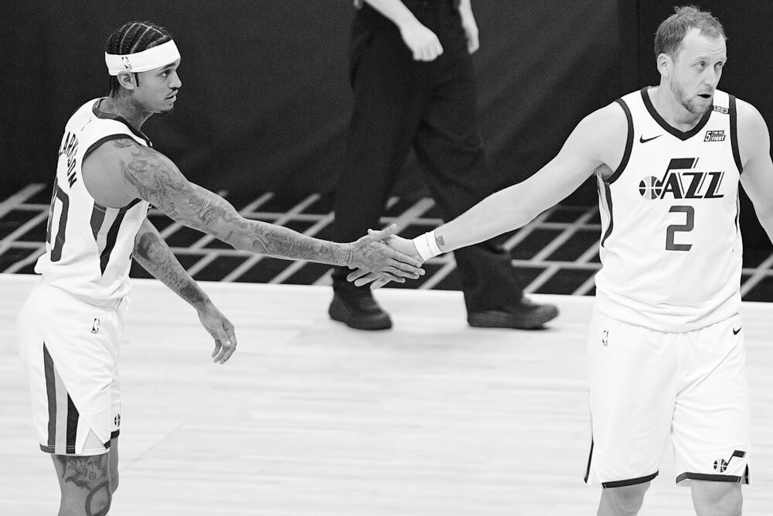
THANK YOU

